Slide 1
What is a Line?
y-axis
A line is the set of points forming a straight path on a plane
The slant (slope) between any two points on a line is always equal
A line on the Cartesian plane can be described by a linear equation
x-axis

Slide 2
Definition - Linear Equation
Any equation that can be put into the form
Ax + By − C = 0, where A, B, and C are Integers and A and B are not both 0, is called a linear equation in two variables.
The graph will be a straight line.
The form Ax + By − C = 0 is called standard form (Integer coefficients all on one side = 0)

Slide 3
Definition - Linear Equation
The equation of a line describes all of the points on the line
The equation is the rule for any ordered pair on the line
Examples:
3x + 2y – 8 = 0
(4, -2) is on the line
(5, 1) is not on the line
x – 7y + 2 = 0
(4, -2) is not on the line
(5, 1) is on the line
Test the point by plugging the x and y into the equation

Slide 4
Slope
Slope describes the direction of a line.

Slide 5
Slope
Why is this needed?
If x₁ ≠ x₂, the slope of the line through the distinct points P₁(x₁, y₁) and P₂(x₂, y₂) is:
Guard against 0 in the denominator

Slide 6
Find the slope between (-3, 6) and (5, 2)
y-axis
(-3, 6)
(5, 2)
x-axis
Rise
-4
-1
=
=
Run
8
2

Slide 7
Calculate the slope between (-3, 6) and (5, 2)
x₁ y₁
x₂ y₂
m
We use the letter m
to represent slope

Slide 8
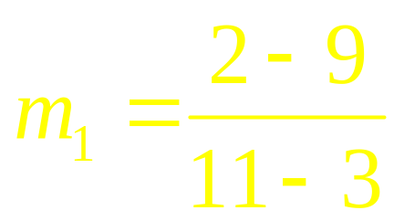
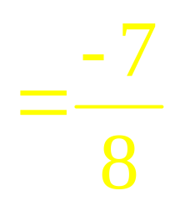
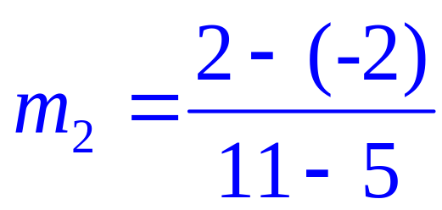
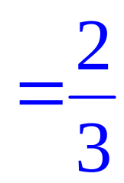
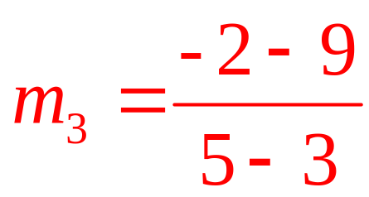
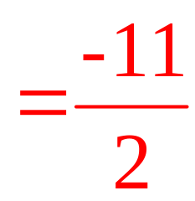
Find the Slopes
Yellow
(3, 9)
Blue
(11, 2)
Red
(5, -2)

Slide 9
Find the slope between (5, 4) and (5, 2).
x₁ y₁
x₂ y₂
STOP
This slope is undefined.

Slide 10
Find the slope between (5, 4) and (5, 2).
y
x
Rise
-2
Undefined
=
=
Run
0

Slide 11
Find the slope between (5, 4) and (-3, 4).
x₁ y₁
x₂ y₂
This slope is zero.

Slide 12
Find the slope between (5, 4) and (-3, 4).
y
x
Rise
0
Zero
=
=
Run
-8

Slide 13
From these results we can see...
The slope of a vertical line is undefined.
The slope of a horizontal line is 0.

Slide 14
Find the slope of the line
4x - y = 8
First, find two points on the line
Let x = 0 to find the
y-intercept.
Let y = 0 to find the
x-intercept.
(0, -8)
(2, 0)
x₁ y₁
x₂ y₂

Slide 15
Find the slope of the line
4x − y = 8
Here is an easier way
Solve for y.
When the equation is solved for y the coefficient of the x is the slope.
We call this the slope-intercept form
y = mx + b
m is the slope and b is the y-intercept

Slide 16
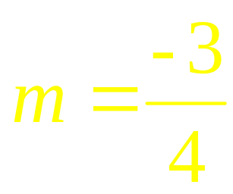
Graph the line that goes through (1, -3) with
(1,-3)
y
x

Slide 17
Sign of the Slope
Which have a
negative slope?
Which have a
positive slope?
Red
Light Blue
White
Undefined
Green
Blue
Zero
Slope

Slide 18
Slope of Parallel Lines
Two lines with the same slope are parallel.
Two parallel lines have the same slope.

Slide 19
Are the two lines parallel?
L₁: through (-2, 1) and (4, 5) and
L₂: through (3, 0) and (0, -2)
This symbol means Parallel

Slide 20
Perpendicular Slopes
4
3
y
x
What can we say
about the intersection
of the two white lines?

Slide 21
Slopes of Perpendicular Lines
If neither line is vertical then the slopes of perpendicular lines are negative reciprocals.
Lines with slopes that are negative reciprocals are perpendicular.
If the product of the slopes of two lines is -1 then the lines are perpendicular.
Horizontal lines are perpendicular to vertical lines.

Slide 22
Write parallel, perpendicular or neither for the pair of lines that passes through (5, -9) and (3, 7) and the line through (0, 2) and (8, 3).
This symbol means Perpendicular

Slide 23
The Equation of a Line

Slide 24
Objectives
Write the equation of a line, given its slope and a point on the line.
Write the equation of a line, given two points on the line.
Write the equation of a line given its slope and y-intercept.

Slide 25
Objectives
Find the slope and the y-intercept of a line, given its equation.
Write the equation of a line parallel or perpendicular to a given line through a given point.

Slide 26
Slope-intercept Form
y = mx + b
m is the slope and b is the y-intercept
Objective
Write the equation of a line, given its slope
and a point on the line.

Slide 27
Write the equation of the line with slope m = 5 and y-int -3
Take the slope intercept form
y = mx + b
y = mx + b
Replace in the m and the b
y = 5x + -3
Simplify
y = 5x – 3
That’s all there is to it…
for this easy question

Slide 28
Find the equation of the line through (-2, 7) with slope m = 3
x y m
Take the slope intercept form
y = mx + b
y = mx + b
7 = mx + b
7 = 3x + b
Replace in the y, m and x
7 = 3(-2) + b
Solve for b
7 = -6 + b
7 + 6 = b
13 = b
Replace m and b back into slope intercept form
y = 3x + 13

Slide 29
Write an equation of the line through (-1, 2) and (5, 7).
First calculate the slope.
Now plug into y, m and x into
slope-intercept form.
(use either x, y point)
Only replace the m and b
Solve for b
Replace back into slope-intercept form

Slide 30
Horizontal and Vertical Lines
If a is a constant, the vertical line though (a, b) has equation x = a.
If b is a constant, the horizontal line though ( a, b,) has equation y = b.
(a, b)

Slide 31
Write the equation of the line through (8, -2); m = 0
Slope = 0 means the line is horizontal
That’s all there is!

Slide 32
Find the slope and y-intercept of
2x – 5y = 1
5
5
5
Solve for y and then we will be able to read it from the answer.
Slope:
y-int:

Slide 33
Write an equation for the line through (5, 7) parallel to 2x – 5y = 15.

Slide 34
Write an equation for the line through (5, 7) parallel to 2x – 5y = 15.
We know the slope and we know a point.
7 = 2 + b
7 – 2 = b
5 = b

Slide 35
Write an equation for the line through (5, 7) parallel to 2x – 5y = 15.

Slide 36
The slope of the perpendicular.
The slope of the perpendicular line is the negative reciprocal of m
Flip it over and change the sign.
Examples of slopes of perpendicular lines:
-2
2.4
2
1
-2
12
-7
= -5
5
3
5
1
2
Note: The product of perpendicular slopes is -1

Slide 37
What about the special cases?
What is the slope of the line perpendicular to a horizontal line?
The slope of a line ⊥ to a horizontal line is undefined.
Well, the slope of a horizontal line is 0…
0
So what’s the negative reciprocal of 0?
0
1
Anything over zero is undefined

Slide 38
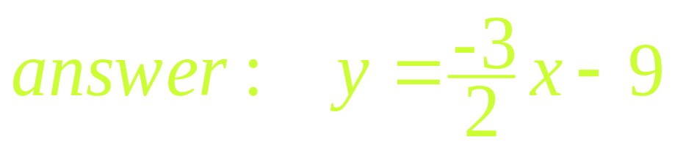
Write an equation in for the line through (-8, 3) perpendicular to 2x – 3y = 10.
2x – 3y = 10
Isolate y to find the slope:
2x = 10 + 3y
2x – 10 = 3y
3 3 3
We know the perpendicular
slope and we know a point.
3 = 12 + b
3 – 12 = b
-9 = b

Slide 39
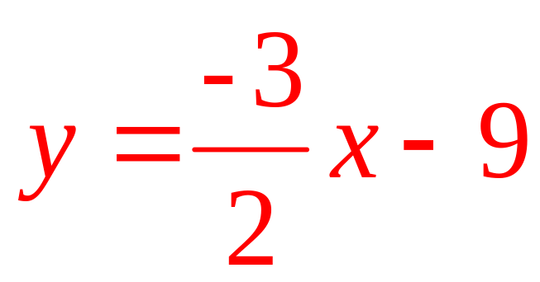
Write an equation in standard form for the line through (-8, 3) perpendicular to
2x - 3y = 10.

Slide 40
Summary
Slope-intercept form
y is isolated
Slope is m.
y-intercept is (0, b)

Slide 41
Summary
Vertical line
  Slope is undefined
  x-intercept is (a, 0)
  no y-intercept
Horizontal line
  Slope is 0.
  y-intercept is (0, b)
  no x-intercept

